Slide 1


Slide 2


Slide 3

1 Kings 17:8-16 (NKJV)
8 “Then the word of the LORD came to him, saying, 9 “Arise, go to Zarephath, which belongs to Sidon, and dwell there. See, I have commanded a widow there to provide for you.”

Slide 4
1 Kings 17:8-16 (NKJV)
10 “So he arose and went to Zarephath. And when he came to the gate of the city, indeed a widow was there gathering sticks. And he called to her and said, “Please bring me a little water in a cup, that I may drink.” 11 And as she was going to get it, he called to her and said, “Please bring me a morsel of bread in your hand.”

Slide 5
1 Kings 17:8-16 (NKJV)
12 “So she said, “As the LORD your God lives, I do not have bread, only a handful of flour in a bin, and a little oil in a jar; and see, I am gathering a couple of sticks that I may go in and prepare it for myself and my son, that we may eat it, and die.”

Slide 6
1 Kings 17:8-16 (NKJV)
13 And Elijah said to her, “Do not fear; go and do as you have said, but make me a small cake from it first, and bring it to me; and afterward make some for yourself and your son.”

Slide 7
1 Kings 17:8-16 (NKJV)
14“For thus says the LORD God of Israel: ‘The bin of flour shall not be used up, nor shall the jar of oil run dry, until the day the LORD sends rain on the earth.’ 15 “So she went away and did according to the word of Elijah; and she and he and her household ate for many days.”

Slide 8
1 Kings 17:8-16 (NKJV)
16 “The bin of flour was not used up, nor did the jar of oil run dry, according to the word of the LORD which He spoke by Elijah.”

Slide 9
THRIVING
IN
GENEROSITY

Slide 10
YOUR HEART WILL FOLLOW YOUR TREASURE

Slide 11
WHATEVER YOUR HEART WRAPS AROUND IT WILL BIRTH IN THE NATURAL.

Slide 12
ACCORDING TO MATTHEW 6 THERE ARE 3 RIGHTEOUS ACT
GIVING (GENEROSITY)
PRAYING
FASTING

Slide 13
RIGHTEOUS PEOPLE ARE GENEROUS AND GENEROUS PEOPLE ARE RIGHTEOUS ACCORDING TO JEWISH THINKING

Slide 14
EVERYTHING OUT OF GOD IS THREE (3) DIMENSIONAL

Slide 15
ACCORDING TO THE BIBLE RIGHTEOUSNESS WAS DEFINED BY GENEROSITY

Slide 16
GIVING IS OUT OF GOD SO IT IS THREE (3) DIMENSIONAL

Slide 17
1
FIRST FRUIT
(TERUMAH)

Slide 18
FIRST FRUITS WAS MENTIONED 87 TIMES IN THE TORAH BUT WAS TRANSLATED 13 DIFFERENT WAYS IN THE ENGLISH BIBLE!

Slide 19
Proverbs 3:9-10 (NKJV)
9 “Honor the LORD with your possessions, And with the first fruits of all your increase;”10 “So your barns will be filled with plenty, And your vats will overflow with new wine.”

Slide 20
Neh 12:44 NIV
44 At that time men were appointed to be in charge of the storerooms for the contributions, firstfruits and tithes. From the fields around the towns they were to bring into the storerooms the portions required by the Law for the priests and the Levites, for Judah was pleased with the ministering priests and Levites.

Slide 21
Num 31:41 NKJV
41 So Moses gave the tribute which was the Lord's heave offering to Eleazar the priest, as the Lord commanded Moses.

Slide 22
Ezek 44:30 NJKV
30 The best of all firstfruits of any kind, and every sacrifice of any kind from all your sacrifices, shall be the priest's; also you shall give to the priest the first of your ground meal, to cause a blessing to rest on your house

Slide 23
Matthew 6:19-23 (NKJV)
19 “Do not lay up for yourselves treasures on earth, where moth and rust destroy and where thieves break in and steal;” 20 “but lay up for yourselves treasures in heaven, where neither moth nor rust destroys and where thieves do not break in and steal.”

Slide 24
Matthew 6:19-23 (NKJV)
21 “For where your treasure is, there your heart will be also.” 22 ““The lamp of the body is the eye. If therefore your eye is good, your whole body will be full of light.”

Slide 25
Matthew 6:19-23 (NKJV)
23 But if your eye is bad, your whole body will be full of darkness. If therefore the light that is in you is darkness, how great is that darkness!

Slide 26
Gal 6:6-9 MESSAGE
6 Be very sure now, you who have been trained to a self-sufficient maturity, that you enter into a generous common life with those who have trained you, sharing all the good things that you have and experience.

Slide 27
Gal 6:6-9 MESSAGE
7 Don't be misled: No one makes a fool of God. What a person plants, he will harvest. The person who plants selfishness, ignoring the needs of others — ignoring God! —

Slide 28
Gal 6:6-9 MESSAGE
8 harvests a crop of weeds. All he'll have to show for his life is weeds! But the one who plants in response to God, letting God's Spirit do the growth work in him, harvests a crop of real life, eternal life.

Slide 29
Gal 6:6-9 MESSAGE
9 So let's not allow ourselves to get fatigued doing good. At the right time we will harvest a good crop if we don't give up, or quit.

Slide 30
THE DIDACHE (DI-DA-KEY)
CHAPTER 13

Slide 31
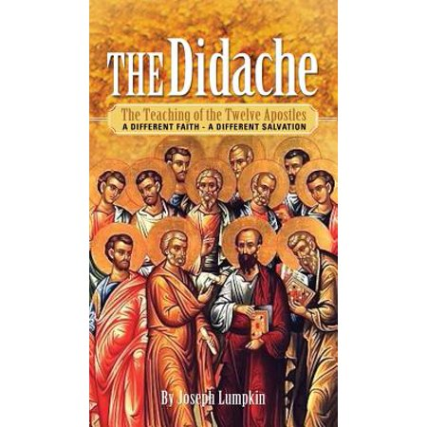

Slide 32
CHAPTER 13
But every true prophet who wants to live among you is worthy of his support. So also a true teacher is himself worthy, as the workman, of his support. Every first fruit, therefore, of the products of the wine-press and threshing-floor, of oxen and of sheep, you shall take and give to the prophets, for they are your high priests.

Slide 33
CHAPTER 13
But if you have no prophet, give it to the poor. If you make a batch of dough, take the first-fruit and give according to the commandment. So also when you open a jar of wine or of oil, take the first-fruit and give it to the prophets; and of money (silver) and clothing and every possession, take the first-fruit, as it may seem good to you, and give according to the commandment.

Slide 34
WHY HONOUR THE FIRSTFRUIT
WE ARE COMMANDED TO
WE ARE TO SHARE ALL GOOD THINGS TO THOSE WHO TEACH US GAL. 6:8-9
GOD GAVE CHRIST FIRST FRUIT

Slide 35
2
TITHE

Slide 36
Malachi 3:8-10 (NKJV)
8 Will a man rob God? Yet you have robbed Me! But you say, ‘In what way have we robbed You?’ In tithes and offerings. 9 You are cursed with a curse, For you have robbed Me, Even this whole nation.

Slide 37
Malachi 3:8-10 (NKJV)
10 “Bring all the tithes into the storehouse, That there may be food in My house, And try Me now in this,” Says the LORD of hosts, “If I will not open for you the windows of heaven And pour out for you such blessing That there will not be room enough to receive it.

Slide 38
1. THE LORD’S TITHE
Gen 14:18-20 NKJV
18 Then Melchizedek king of Salem brought out bread and wine; he was the priest of God Most High. 19 And he blessed him and said: "Blessed be Abram of God Most High, Possessor of heaven and earth; 20 And blessed be God Most High, Who has delivered your enemies into your hand.“ And he gave him a tithe of all.
SEE ALSO HEBREWS 6,7

Slide 39
1. THE LORD’S TITHE
Num 18:21, 24 NIV
21 "I give to the Levites all the tithes in Israel as their inheritance in return for the work they do while serving at the Tent of Meeting
24 Instead, I give to the Levites as their inheritance the tithes that the Israelites present as an offering to the Lord. That is why I said concerning them: 'They will have no inheritance among the Israelites.'"

Slide 40
1. THE LORD’S TITHE
Num 18:21, 24 NIV
21 "I give to the Levites all the tithes in Israel as their inheritance in return for the work they do while serving at the Tent of Meeting
24 Instead, I give to the Levites as their inheritance the tithes that the Israelites present as an offering to the Lord. That is why I said concerning them: 'They will have no inheritance among the Israelites.'"

Slide 41
2. THE TITHE TO YOURSELF
Deut 14:22-27 NKJV
22 "You shall truly tithe all the increase of your grain that the field produces year by year. 23 And you shall eat before the Lord your God, in the place where He chooses to make His name abide, the tithe of your grain and your new wine and your oil, of the firstborn of your herds and your flocks, that you may learn to fear the Lord your God always. 24 But if the journey is too long for you, so that you are not able to carry the tithe, or if the place where the Lord your God chooses to put His name is too far from you, when the Lord your God has blessed you,

Slide 42
2. THE TITHE TO YOURSELF
Deut 14:22-27 NKJV
25 then you shall exchange it for money, take the money in your hand, and go to the place which the Lord your God chooses. 26 And you shall spend that money for whatever your heart desires: for oxen or sheep, for wine or similar drink, for whatever your heart desires; you shall eat there before the Lord your God, and you shall rejoice, you and your household. 27 You shall not forsake the Levite who is within your gates, for he has no part nor inheritance with you.

Slide 43
3. THE TITHE TO THE POOR
Deut 14:28-29 NKJV
28 "At the end of every third year you shall bring out the tithe of your produce of that year and store it up within your gates. 29 And the Levite, because he has no portion nor inheritance with you, and the stranger and the fatherless and the widow who are within your gates, may come and eat and be satisfied, that the Lord your God may bless you in all the work of your hand which you do

Slide 44
3
OFFERINGS

Slide 45
2 Cor 9:6-8 NKJV
6 But this I say: He who sows sparingly will also reap sparingly, and he who sows bountifully will also reap bountifully. 7 So let each one give as he purposes in his heart, not grudgingly or of necessity; for God loves a cheerful giver.

Slide 46
PRACTICAL REALITY

Slide 47
1. FIRST-FRUITS
IF EARN N50,000.00 MONTHLY
FIRSTFRUIT (2.5% * N50,000.00) = N1,250.00

Slide 48
2. THE LORD’S TITHE
IF EARN N50,000.00 MONTHLY
THE LORD’S TITHE (10% * N50,000.00) = N5,000.00

Slide 49
3. THE TITHE TO YOURSELF
IF EARN N50,000.00 MONTHLY
TITHE TO SELF (10% AFTER FIRST FRUIT, THE LORD’S TITHE AND TAXES)
(N50,000.00 – N1,250.00 – N5,000.00 = N43,750.00)
10% * N43,750.00 = N4,375.00

Slide 50
4. THE TITHE TO THE POOR
IF EARN N50,000.00 MONTHLY
TITHE TO SELF (10% AFTER FIRST FRUIT, THE LORD’S TITHE AND TAXES)
(N50,000.00 – N1,250.00 – N5,000.00 = N43,750.00)
10% * N43,750.00 = N4,375.00 (EVERY 3 MONTHS)

Slide 51
PRACTICAL REALITY
IF EARN N50,000.00 MONTHLY
BALANCE AFTER FIRST FRUIT AND TITHES
N50,000.00 – N1,250.00 – N5,000.00 – N4,375.00 = N39,375.00

Slide 52
PRACTICAL REALITY
N39,375.00 REPRESENTS 78.75% OF N50,000.00!
GOD IS A GENIUS!

Slide 53
Lev 19:9-10 NCV
9 "'When you harvest your crops on your land, do not harvest all the way to the corners of your fields. If grain falls onto the ground, don't gather it up. 10 Don't pick all the grapes in your vineyards, and don't pick up the grapes that fall to the ground. You must leave those things for poor people and for people traveling through your country. I am the Lord your God

Slide 54
Lev 23:22 NCV
22 "'When you harvest your crops on your land, do not harvest all the way to the corners of your field. If grain falls onto the ground, don't gather it up. Leave it for poor people and foreigners in your country. I am the Lord your God.'"

Slide 55
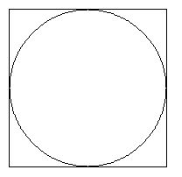
IF YOU INSERT A CIRCLE IN A SQUARE IT WILL OCCUPY 79% OF THE SQUARE

Slide 56


Slide 57
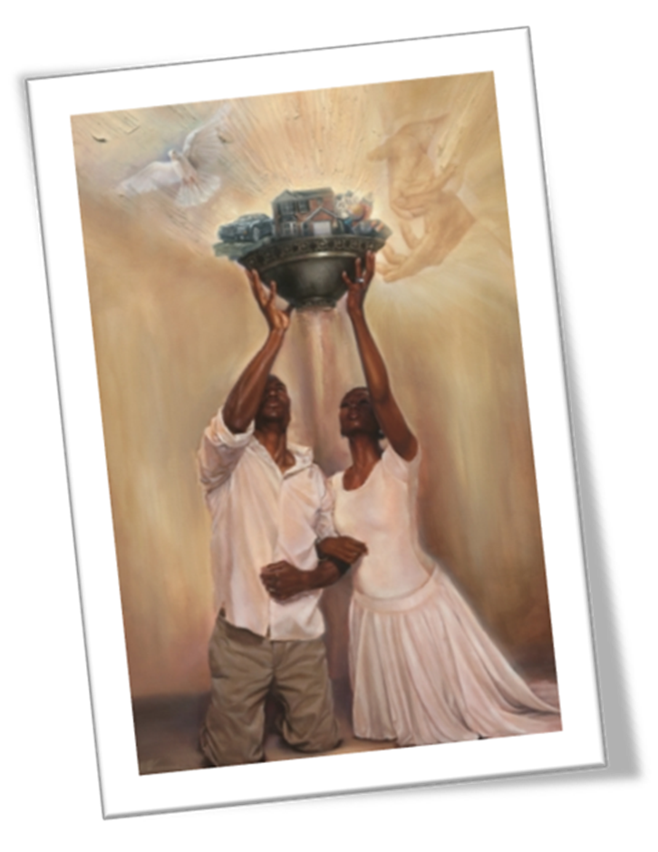
Offering
Declaration!

Slide 58
As we pray for new wells of SPIRITUAL revival, we pray for new ECONOMIC wells in EDO STATE and NIGERIA to be created. So Lord we ask you for: Favour for our city with CEO’s, Government leaders & Kings. Manufacturing firms that produce goods for the nations and provide new jobs for our people. Technology to establish new markets, energy sources, and efficient solutions to grow as a population.

Slide 59
Laws & Courts that measure with the justice and the freedom of our land’s Constitution. Civil servants that encourage entrepreneurs. Media known for wisdom & truth. Natural resources released, harvested, sold & reproduced. Education, books, and Universities that develop mind moulders who influence the influential.

Slide 60
Capital to build small businesses that provide services,
Arts and culture attracting both young and old. Medical community known for integrity and excellence. Repentance from poverty, small thinking, and envy. Courage to recognize opportunities and make wealth.

Slide 61
Abundance to bless the world and the Prudence to save and invest. Revelation to pass on wealth to our children’s children.
So we declare that when the righteous prosper, the city rejoices!
Hallelujah!!!!!!

