Slide 1

2019 FAST
KAY BENSON-AKHIGBE II

Slide 2
What is THRIVE?
“take hold of”
“to seize”
“to flourish”

Slide 3
What is THRIVE?
Prosper
Grow vigorously
Develop well
Bloom/blossom
Do well
Advance
Make strides
Succeed

Slide 4
What is Fasting?
Receiving the announcements of his divine will and executing the written justice.

Slide 5
Dan 9:2
In the first year of his reign I, Daniel, understood by the books the number of the years specified by the word of the LORD through Jeremiah the prophet, that He would accomplish seventy years in the desolations of Jerusalem.
Dan 9:3 Then I set my face toward the Lord God to make request by prayer and supplications, with fasting, sackcloth, and ashes.

Slide 6
The man of prayer exerts a greater influence over national affairs than even crowned heads. "Prayer moves the hand that moves the world.
Daniel on his knees was a mightier man than Darius on his throne. Daniel was in the service of the King of kings was admitted to the audience-chamber of the Most High; and received the announcements of the Divine will. Darius now mainly serves as a landmark on the course of time to indicate a date; Daniel is still the teacher and moulder of men.

Slide 7
What is Fasting?

Slide 8
Mat 17:14 When they came to the crowd, a man came up to Jesus, falling on his knees before Him and saying,
Mat 17:15 "Lord, have mercy on my son, for he is a lunatic and is very ill; for he often falls into the fire and often into the water.

Slide 9
Mat 17:16 "I brought him to Your disciples, and they could not cure him."
Mat 17:17 And Jesus answered and said, "You unbelieving and perverted generation, how long shall I be with you? How long shall I put up with you? Bring him here to Me."

Slide 10
Mat 17:18 And Jesus rebuked him, and the demon came out of him, and the boy was cured at once.
Mat 17:19 Then the disciples came to Jesus privately and said, "Why could we not drive it out?"

Slide 11
Mat 17:20 And He said to them, "Because of the littleness of your faith; for truly I say to you, if you have faith the size of a mustard seed, you will say to this mountain, `Move from here to there,' and it will move; and nothing will be impossible to you.
Mat 17:21 ["But this kind does not go out except by prayer and fasting."]

Slide 12
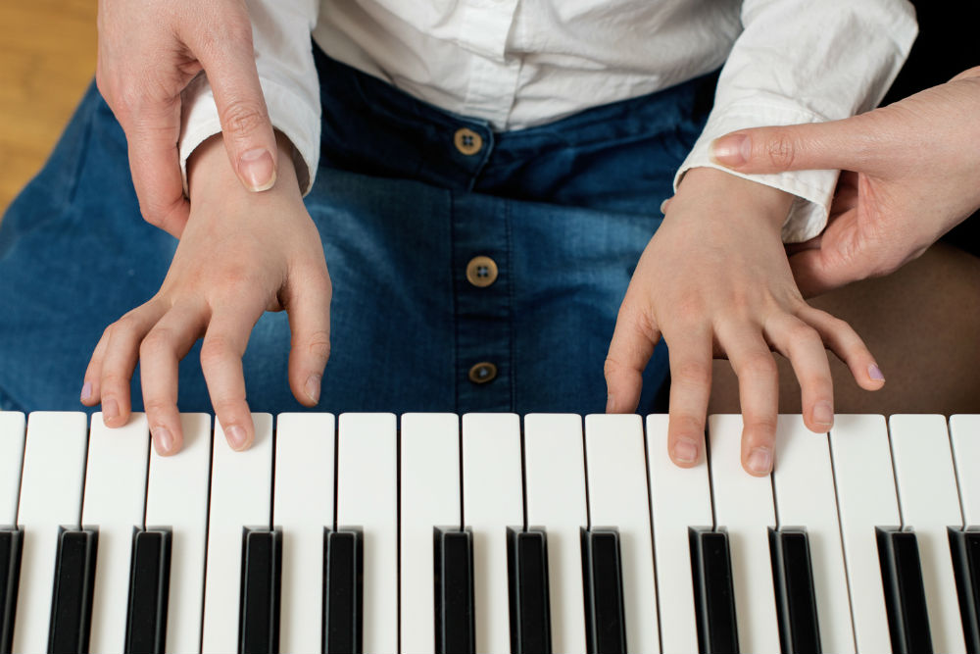
Are you a practicing Christian?

Slide 13
“The things we must train ourselves to do frequently and regularly to grow in our discipleship”.
Richard Foster's
“The Celebration of Discipline”

Slide 14
Corporate Disciplines
Confession of sins
Worship
Celebration
Seeking/Giving Guidance

Slide 15
The Outward Disciplines
Simplicity
Solitude
Submission
Service

Slide 16
The Inward Disciplines
Meditation
Prayer
Fasting
Study

Slide 17
Fasting is one of the least understood, the least and incorrectly practiced discipline in Christianity.

Slide 18
I am persuaded that a Christian who has understood the need to fast and does not practice fasting, will backside just as surely as a Christian who understood the need to pray and will not pray.
John Wesley

Slide 19
“So little is said about fasting, yet it seems to me it’s a duty that all professing Christians should practice.
There are so many occasions of both a spiritual and temporal nature that do properly require it”
Jonathan Edwards

Slide 20
What is Fasting?
Abstaining from food and pleasure for spiritual purpose.

Slide 21
Dan 10:3
I ate no pleasant food, no meat or wine came into my mouth, nor did I anoint myself at all, till three whole weeks were fulfilled.

Slide 22
Fasting in other faiths
Judaism – Yom Kippur, Tisha B’Av
Buddhism – during extreme meditations
Hinduism – critical
Bahai – one month a year
Islam – Ramadan

Slide 23
Examples of fasting in the Bible
Darius: Dan 6:18 Now the king went to his palace and spent the night fasting; and no musicians were brought before him. Also his sleep went from him.
Cornelius: Act 10:30 So Cornelius said, "Four days ago I was fasting until this hour; and at the ninth hour I prayed in my house, and behold, a man stood before me in bright clothing,

Slide 24
Ezr 8:21 Then I proclaimed a fast there at the river of Ahava, that we might humble ourselves before our God to seek from Him a safe journey for us, our little ones, and all our possessions.
Ezr 8:22 For I was ashamed to request from the king troops and horsemen to protect us from the enemy on the way, because we had said to the king, "The hand of our God is favorably disposed to all those who seek Him, but His power and His anger are against all those who forsake Him."
Ezr 8:23 So we fasted and sought our God concerning this matter, and He listened to our entreaty.

Slide 25
Lev 23:26 The LORD spoke to Moses, saying,
Lev 23:27 "On exactly the tenth day of this seventh month is the day of atonement; it shall be a holy convocation for you, and you shall humble your souls and present an offering by fire to the LORD.
Lev 23:28 "You shall not do any work on this same day, for it is a day of atonement, to make atonement on your behalf before the LORD your God.
Lev 23:29 "If there is any person who will not humble himself on this same day, he shall be cut off from his people.

Slide 26
1Ki 21:21 "Behold, I will bring evil upon you, and will utterly sweep you away, and will cut off from Ahab every male, both bond and free in Israel;
1Ki 21:22 and I will make your house like the house of Jeroboam the son of Nebat, and like the house of Baasha the son of Ahijah, because of the provocation with which you have provoked Me to anger, and because you have made Israel sin.
1Ki 21:23 "Of Jezebel also has the LORD spoken, saying, `The dogs will eat Jezebel in the district of Jezreel.'

Slide 27
1Ki 21:24 "The one belonging to Ahab, who dies in the city, the dogs will eat, and the one who dies in the field the birds of heaven will eat."
1Ki 21:25 Surely there was no one like Ahab who sold himself to do evil in the sight of the LORD, because Jezebel his wife incited him.
1Ki 21:26 He acted very abominably in following idols, according to all that the Amorites had done, whom the LORD cast out before the sons of Israel.

Slide 28
1Ki 21:27 It came about when Ahab heard these words, that he tore his clothes and put on sackcloth and fasted, and he lay in sackcloth and went about despondently.
1Ki 21:28 Then the word of the LORD came to Elijah the Tishbite, saying,
1Ki 21:29 "Do you see how Ahab has humbled himself before Me? Because he has humbled himself before Me, I will not bring the evil in his days, but I will bring the evil upon his house in his son's days."

Slide 29
Est 4:13 Then Mordecai told them to reply to Esther, "Do not imagine that you in the king's palace can escape any more than all the Jews.
Est 4:14 "For if you remain silent at this time, relief and deliverance will arise for the Jews from another place and you and your father's house will perish. And who knows whether you have not attained royalty for such a time as this?"

Slide 30
Est 4:15 Then Esther told them to reply to Mordecai,
Est 4:16 "Go, assemble all the Jews who are found in Susa, and fast for me; do not eat or drink for three days, night or day. I and my maidens also will fast in the same way. And thus I will go in to the king, which is not according to the law; and if I perish, I perish."

Slide 31
Jon 3:6 When the word reached the king of Nineveh, he arose from his throne, laid aside his robe from him, covered himself with sackcloth and sat on the ashes.
Jon 3:7 He issued a proclamation and it said, "In Nineveh by the decree of the king and his nobles: Do not let man, beast, herd, or flock taste a thing. Do not let them eat or drink water.

Slide 32
Jon 3:8 "But both man and beast must be covered with sackcloth; and let men call on God earnestly that each may turn from his wicked way and from the violence which is in his hands.
Jon 3:9 "Who knows, God may turn and relent and withdraw His burning anger so that we will not perish."
Jon 3:10 When God saw their deeds, that they turned from their wicked way, then God relented concerning the calamity which He had declared He would bring upon them. And He did not do it.

Slide 33
Examples of fasting in the Bible
Benjamites: Judges 20
Daniel: Daniel 10
Israel: 1 Sam. 7, 1 Sam. 31;
Isaiah 58; Exodus 34; Acts 14,
Jesus: Matthew 4; Mark 9

Slide 34
The Biblical Purpose Of Fasting
Subdue the Flesh
Rom. 7:15-25; 6:1-14

Slide 35
The Biblical Purpose Of Fasting
2. Strengthen the Spirit.

Slide 36
The Biblical Purpose Of Fasting
3. Discern the will of God.
Acts 13:1-3

Slide 37
The Biblical Purpose Of Fasting
4. Unity with Believers.

Slide 38
Fasting is not…
Necessary for salvation – it is a work and therefore incapable of saving.
A way of manoeuvring or manipulating the will of God.
A spiritual gift or badge of anointing/boasting (Matt. 6:16)

Slide 39
GUIDELINES

Slide 40
Sense a call/need to fast either personally or corporately.

Slide 41
How to Begin
Start with a clear. Determine the specific goal and desired outcome of the fast.
Why are you fasting?
Ask the Holy Spirit for guidance.
Pray daily and read the Bible.

Slide 42
Preparing Spiritually

Slide 43
Confess your sins to God. Ask the Holy Spirit to reveal areas of weakness.
Forgive all who have offended you and ask forgiveness from those you may have offended (Mark 11:25; Luke 11:4; 17:3-4).
Surrender your life fully to Jesus Christ and reject the worldly desires that try to hinder you (Romans 12:1-2).

Slide 44
Choose a type of fast and decide how long it will be.

Slide 45
Types of Fasts
Daniel Fast – Diet
Black Fast. Isaiah 58:1-7
Other types of fasts;
Television, Social media, Computer games/Email, Telephone, Unnecessary talk.

Slide 46
40 DAYS OF SONS THRIVING COPORATE FAST 2019 GOALS
Redemptive destiny of Nigeria & Edo State.
That the body of Christ should stop eating itself.
.Courtroom activities
Preparation for 2020
Becoming the best you were created to be
Personal spiritual discipline

Slide 47
Three areas where we are to observe this fast;
Physical
Social
Financial
Remember to replace this times with prayer and Bible study.

Slide 48
THRIVE 2019 – Physical Option 1
Choose at least one
Change in Diet
Daniel Fast (abstain from sweets and meats, and the only liquid he drank was water)
Full fast in which you only drink liquids
No food from 6pm-6am
Eliminate sweets, caffeine, and/or alcoholic beverages.

Slide 49
THRIVE 2019 – Physical Option 2
Change in Physical activities
30 minutes a day of physical exercise (weekdays)
1 hr in the prayer room 7am-1pm or 5pm-6pm (weekdays)

Slide 50
THRIVE 2019 – Physical Challenge
During the final 3 days of the fast (Sept. 16-18), participants who accept this challenge will partake in a water only fast.
(We ask that all participants check with their primary care physicians before making any changes to their diet).

Slide 51
THRIVE 2019 – Social Option 1
Please choose one
Change in social interactions
Eliminate social media (i.e. Instagram, Facebook, Twitter, Snapchat, etc.)
Eliminate television and movies (cable and satellite TV, movie theaters, Netflix, Iroko TV etc.)
Both

Slide 52
THRIVE 2019 – Social Option 2
Change in spiritual interactions
Find a prayer partner with whom to pray daily.

Slide 53
THRIVE 2019 – Social Challenge
During the final 3 days of the fast (Sept. 16-18), participants who accept this challenge will partake in a 3-day silent meditation. Participants are asked to silence themselves from unnecessary conversations and noises.
(These may include but are not limited to phone conversations, music, background noise, etc.)

Slide 54
THRIVE 2019 – Financial Option 1
Change in frivolous spending
Eliminate spending money on non-essential daily routine purchases (i.e. Soda, recharge cards etc.)
~ collect money saved as an offering to render back to God at the end of the fast ~

Slide 55
THRIVE 2019 – Financial Option 2
Change in personal spending
Eliminate spending money on non-essential items (i.e. extra clothing, electronics, etc.)
~ collect money saved as an offering to render back to God at the end of the fast ~

Slide 56
THRIVE 2019 – Financial Challenge
During the final 3 days of the fast (Sept. 16-18), participants who accept this challenge will partake in a 3-day financial discernment. Participants are asked to discern an amount of money to offer back to God. ALL funds will be donated to host our city and a cause at the end of THRIVE 2019.
(Offering amount may reflect money saved during the fast or participants may choose to add additional funds to their donation)

Slide 57



